Slide 1



DR. PANJABRAO DESHMUKH POLYTECHNIC, AMRAVATI
service provision management system
Group Members:
Ayan A. Khan [ 15 ]
Jayesh P. Dhole [ 16 ]
Sarthak D. Garibe [ 22 ]
Yash V. Raut [ 24 ]
Subject: CPE Project Presentation
Guided by: Prof. G.R. Gosavi.

Slide 2
What is SPMS?
Website for local service booking.
Connection between Provider and Consumer.
Viewing providers.
Getting work done.
Service
Facility or work
Provision
That’s to be given
Management
And managed
System
Using a structure
SPMS

Slide 3





Similar Software's.
SPMS

Slide 4

Literature Review
Core Java Volume I – Fundamentals.
Basic Service Management.
Beginning Database Design Solutions.
HTML & CSS: Design and Build Web Sites.
https://www.urbancompany.com.
SPMS

Slide 5
Structure.
Provider only:
Provider profile
Wages declaration.
Requests.
Registration
Login
Service Listing
Provider Listing
Selection
Accomplishment
Bill generation
SPMS

Slide 6
Programming Languages.
HTML
JAVA
CSS
MySQL
Backend
Frontend
Design
Database
SPMS

Slide 7

Methodologies.
JDBC bridge
MySQL Server
Normalization
Triggering
Report Writing
SPMS

Slide 8
Dataflow.
Wages database
Provider database
Get service
Get respective providers
Get Wages & Taxes
Get provider Details
Registration Screen
Login
Home Screen
Provider listing
Invoice
Print bill
Start
Register user details
User type
Get Credentials
Get provider
Consumer database
Admin database
Request approval
Work Status
SPMS

Slide 9
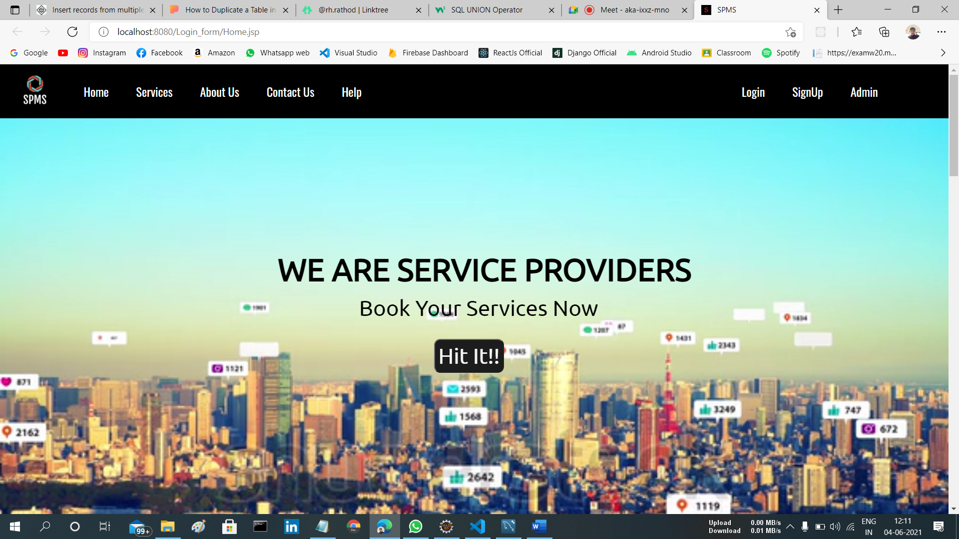
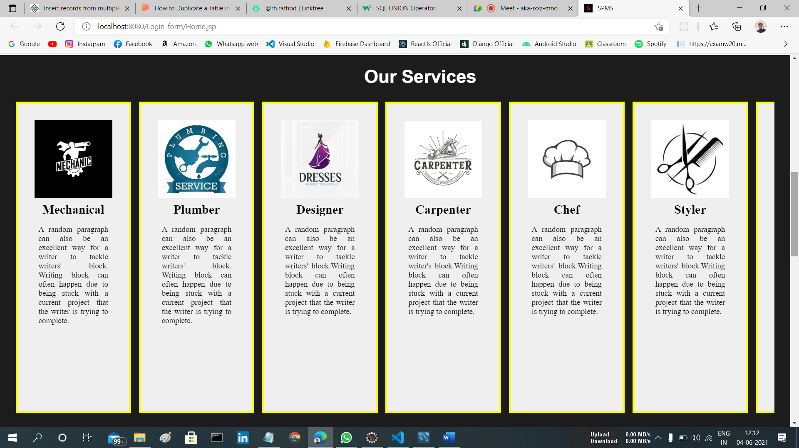
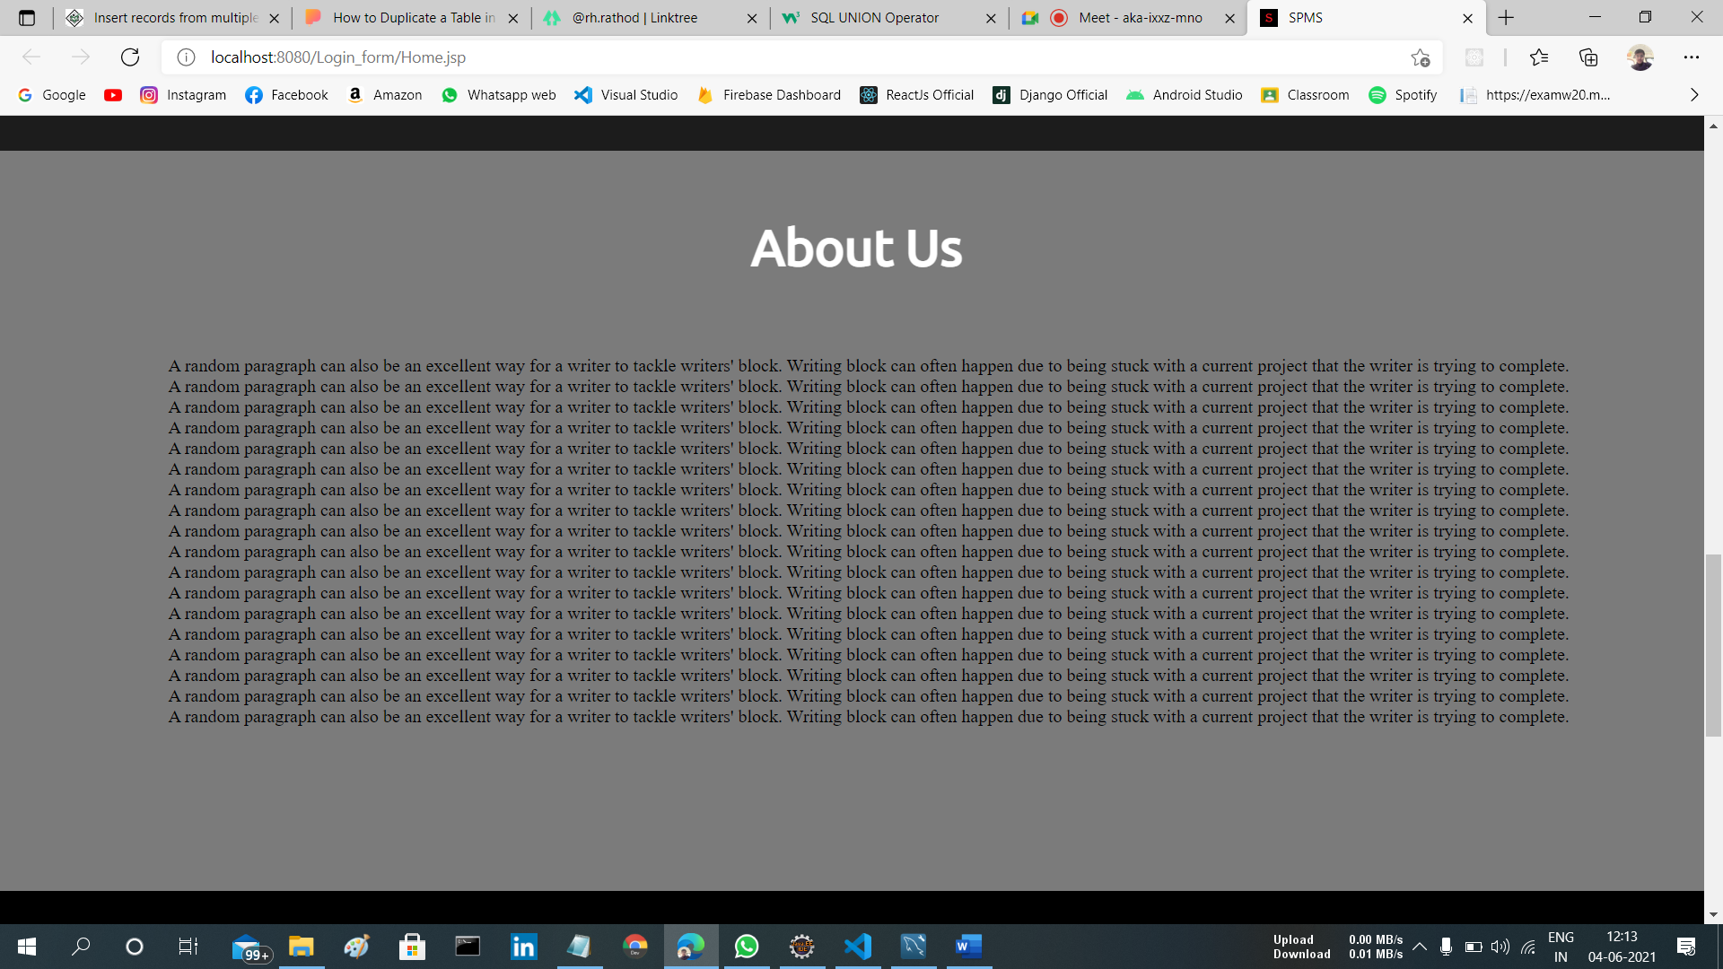
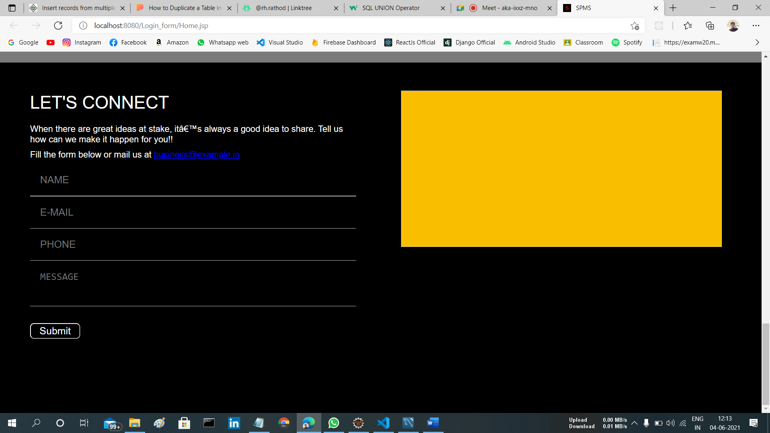
Homepage.
SPMS

Slide 10
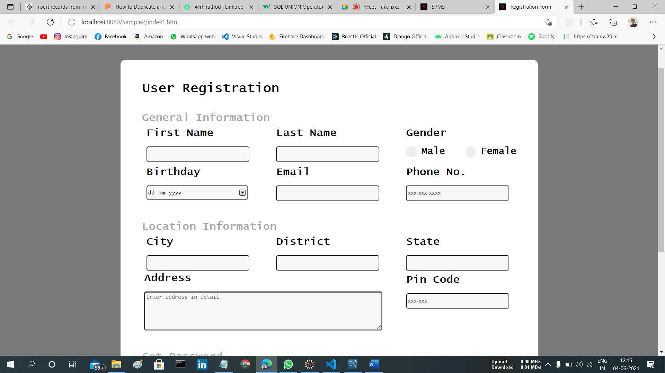
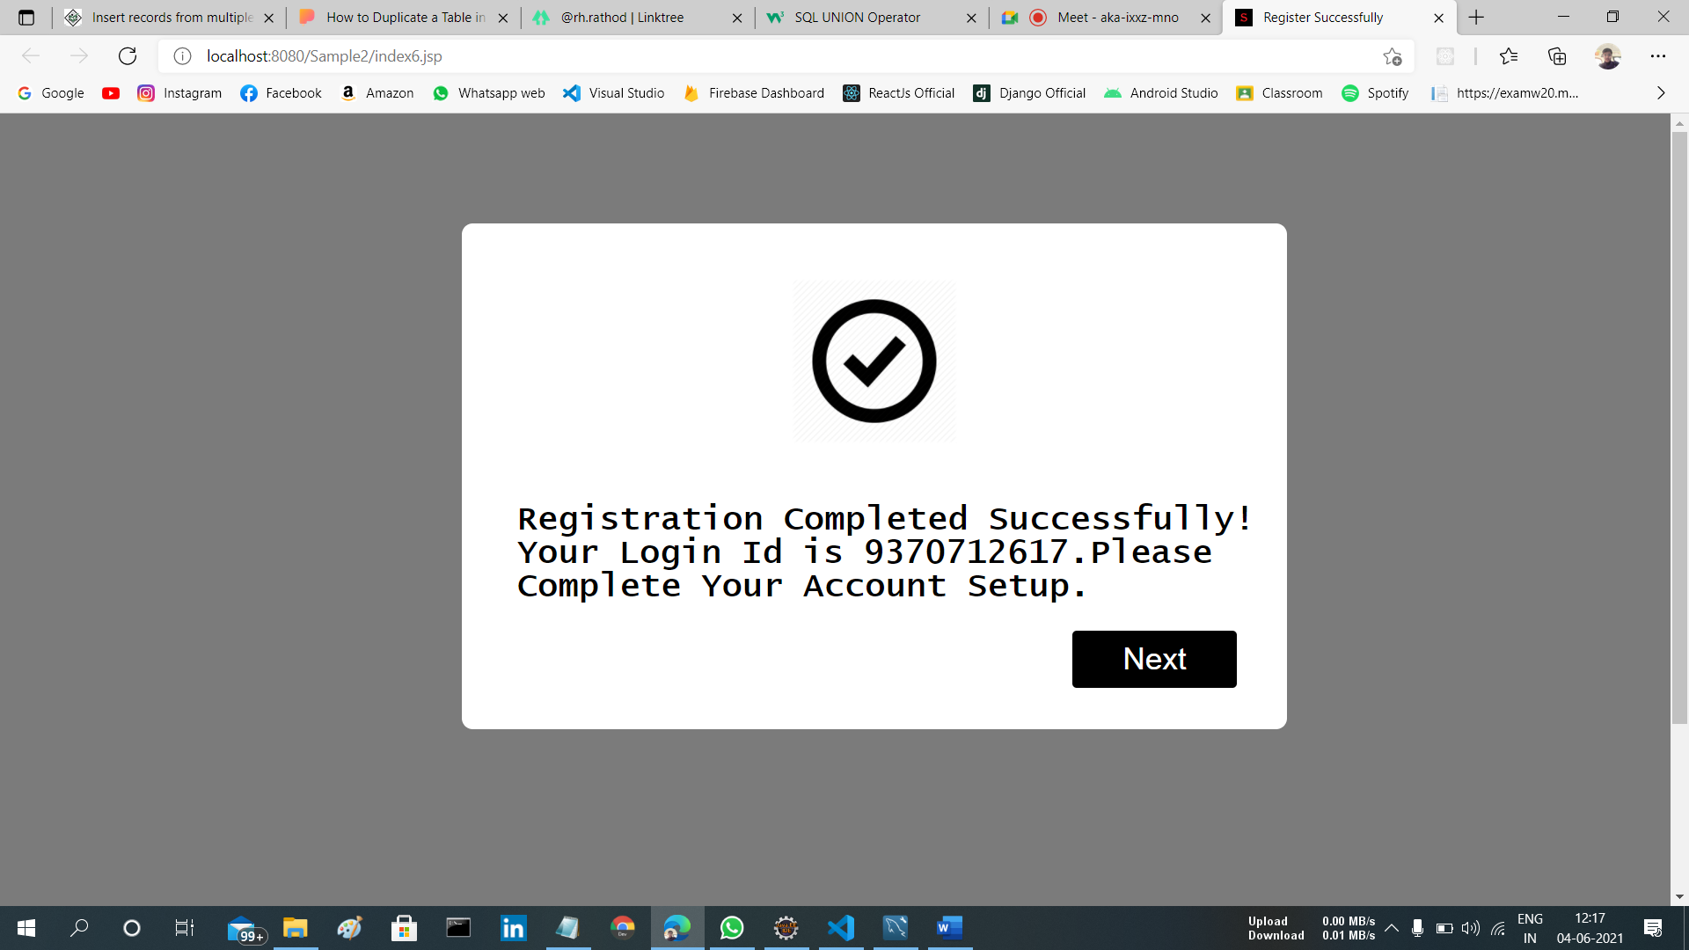
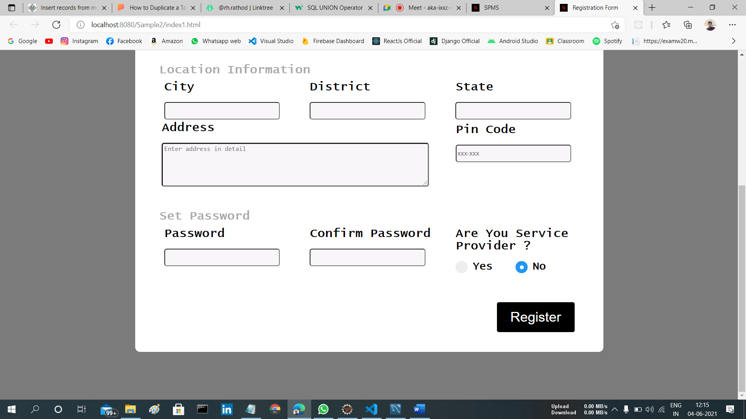
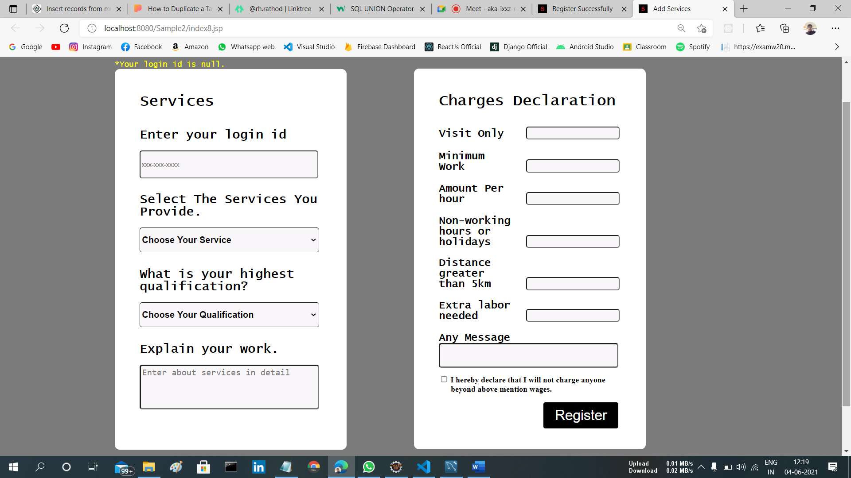
Registration.
SPMS

Slide 11
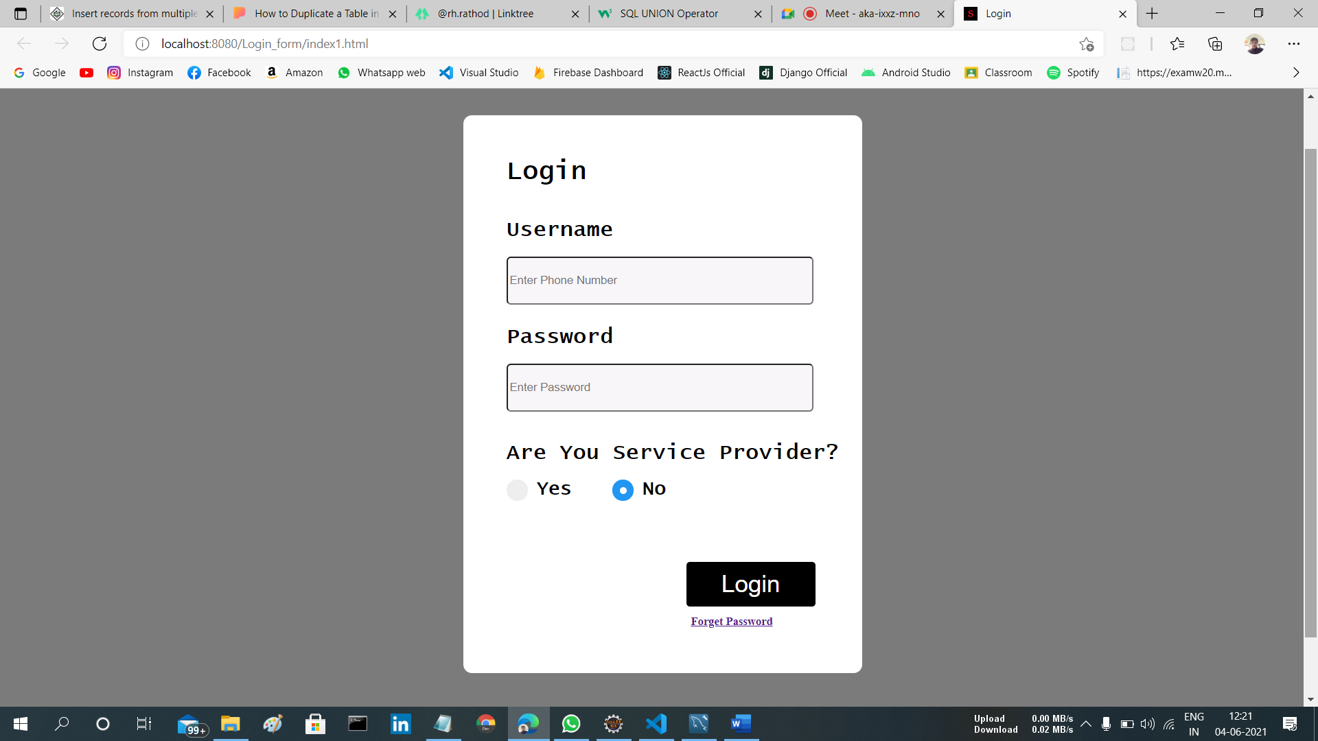
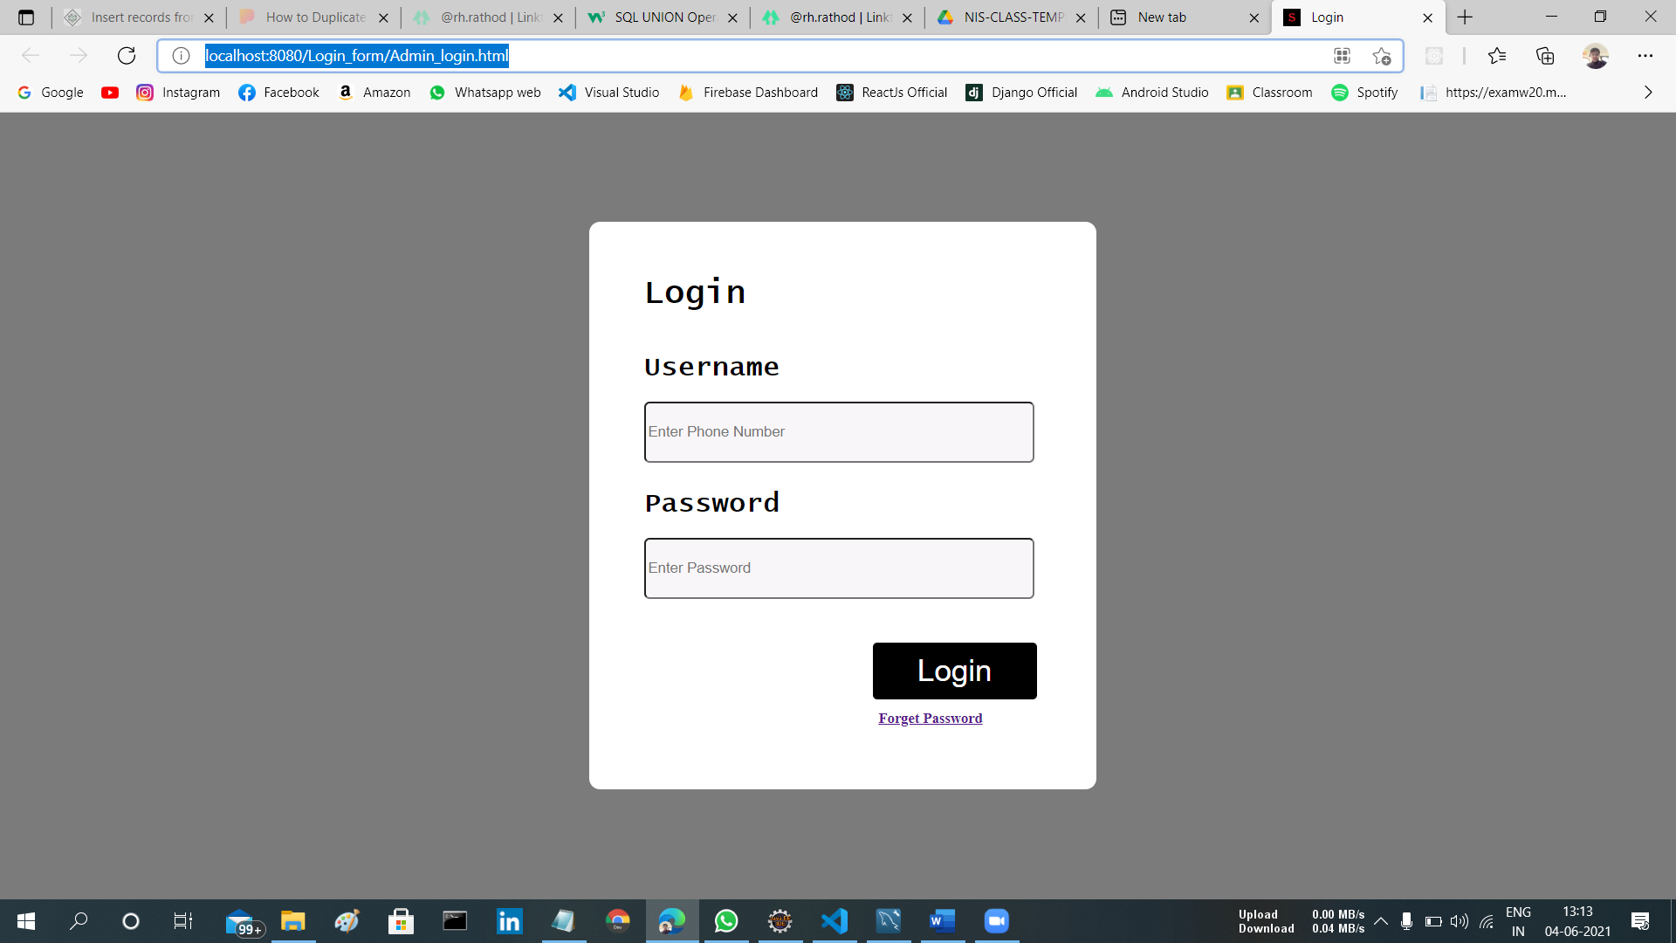
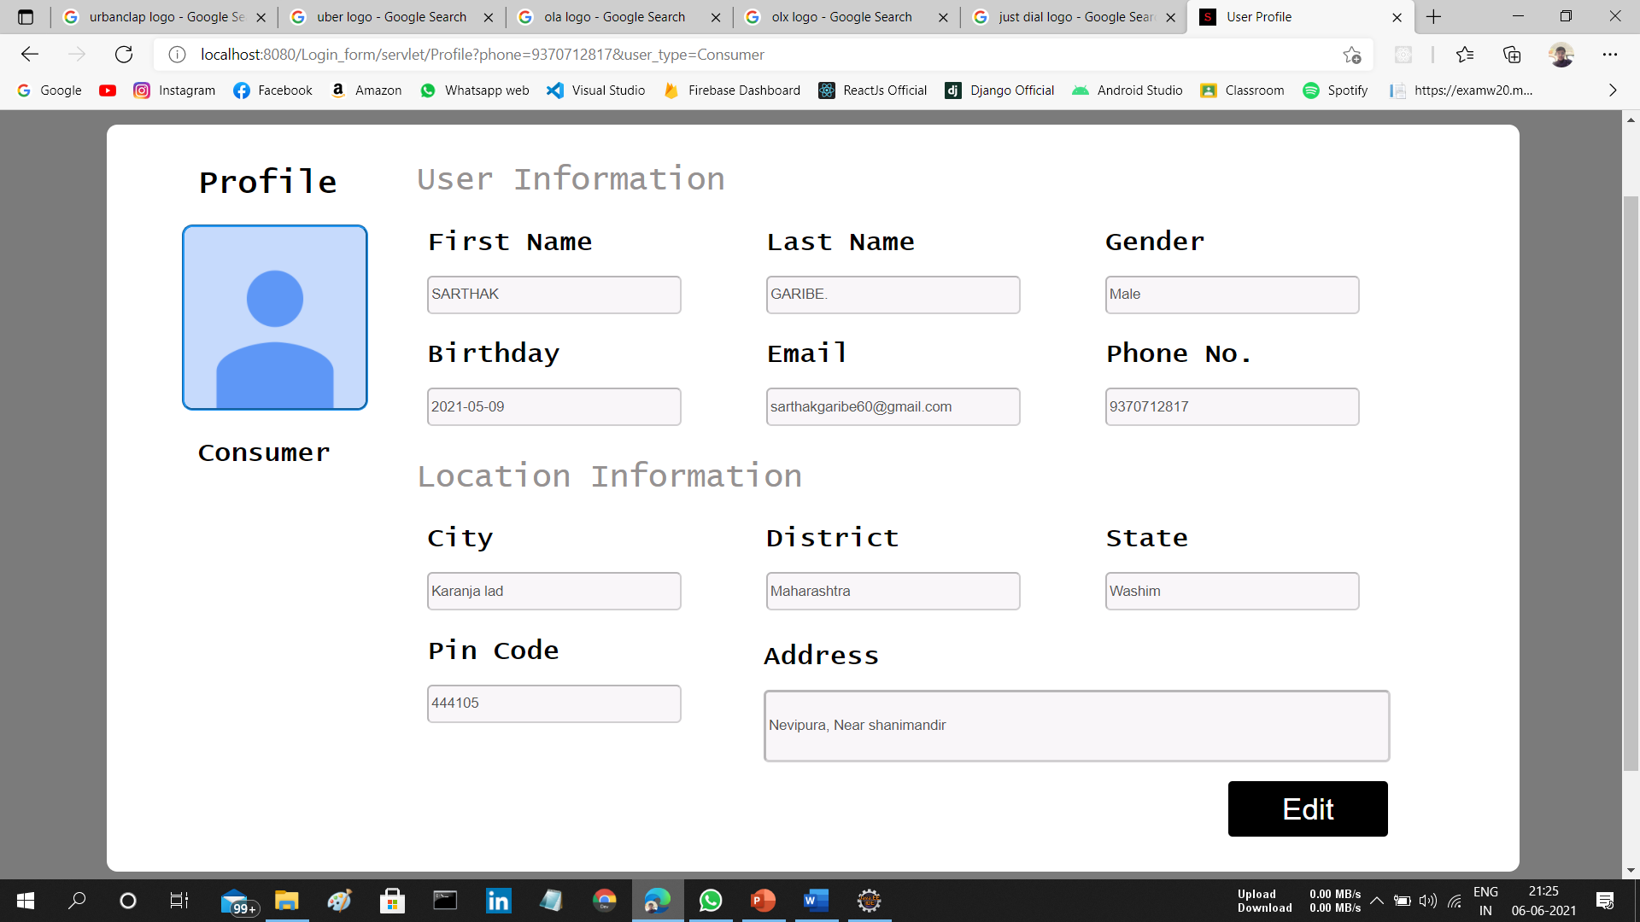
Login.
Users.
Admin.
Profile.
SPMS

Slide 12
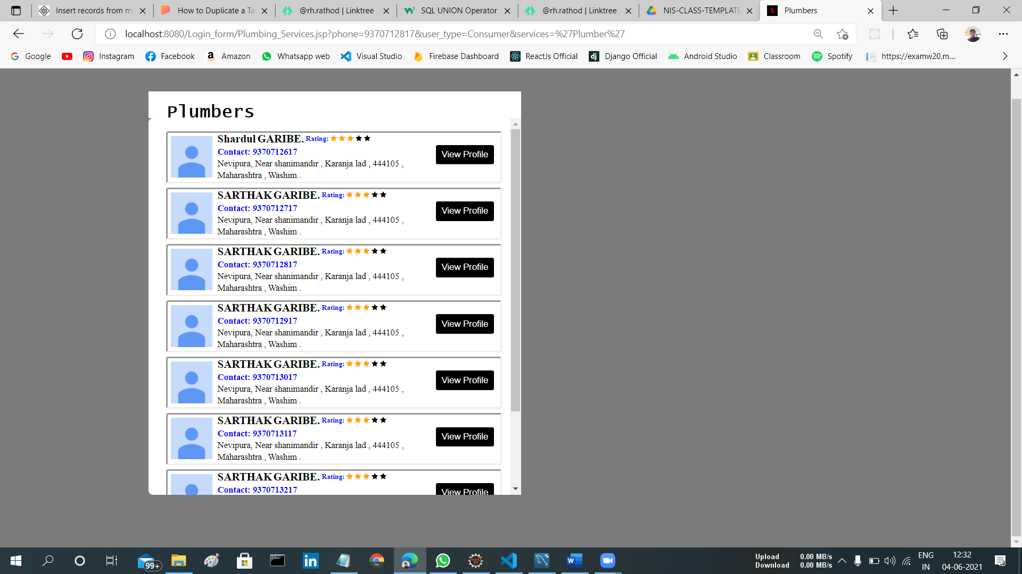
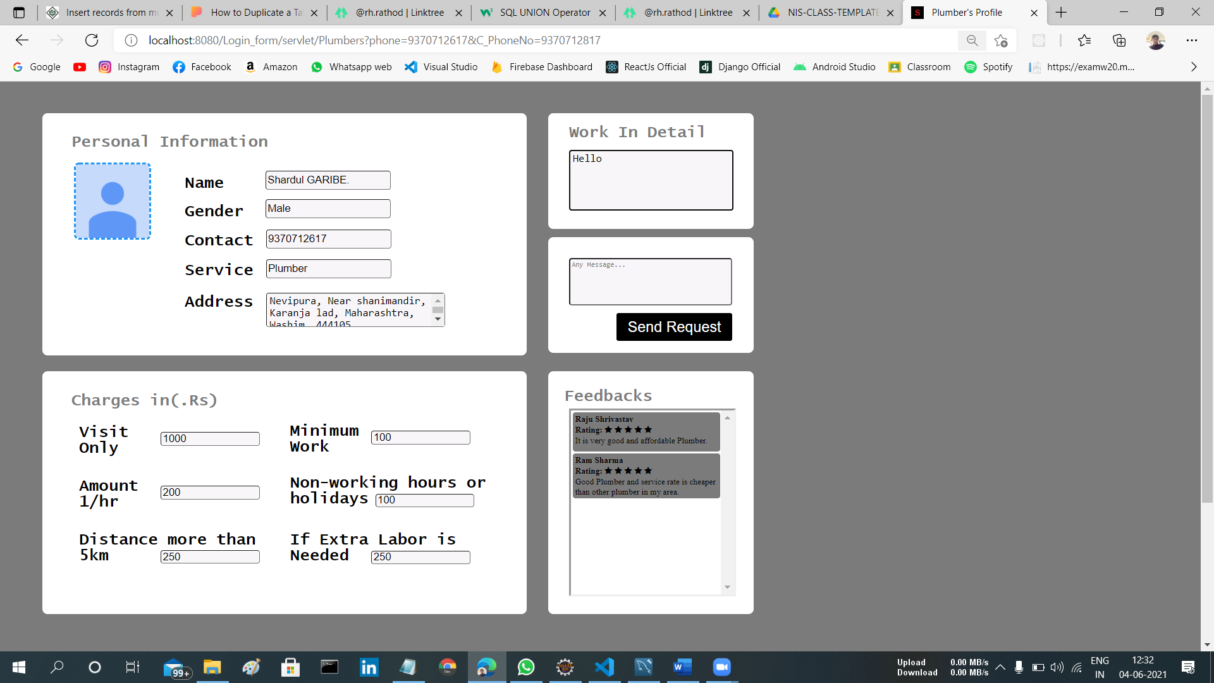
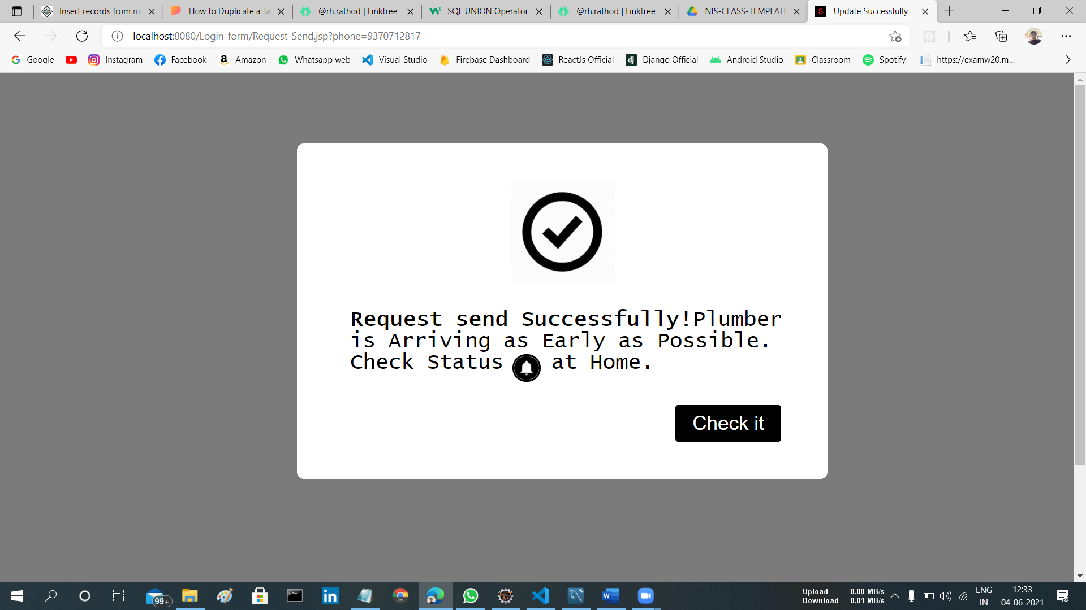
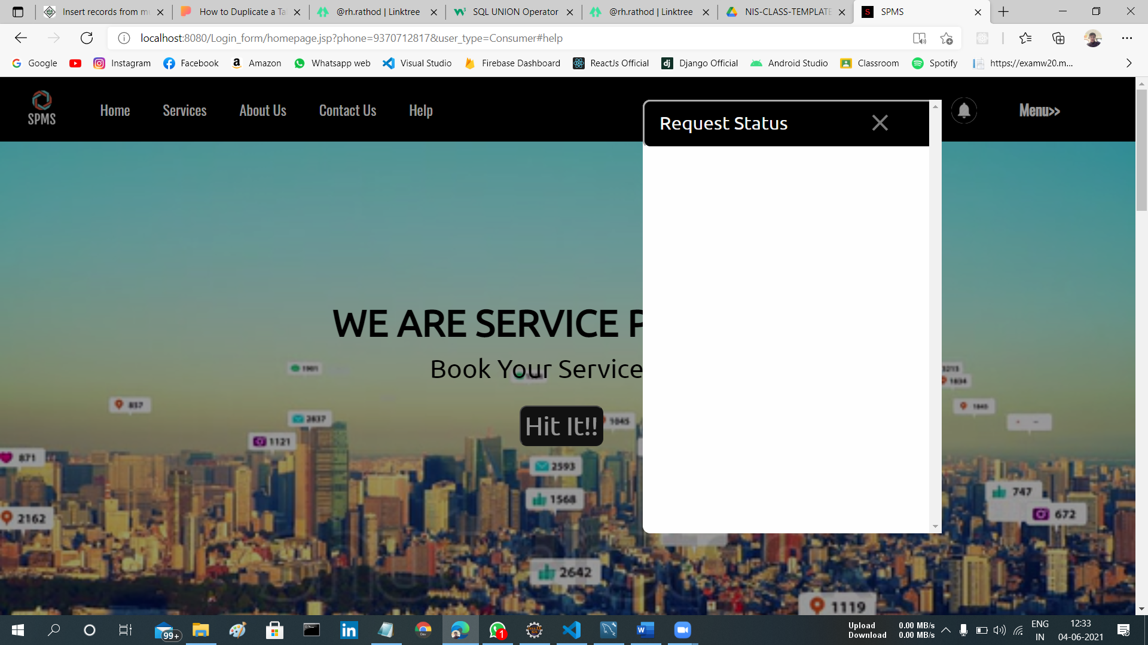
Send Request.
SPMS

Slide 13
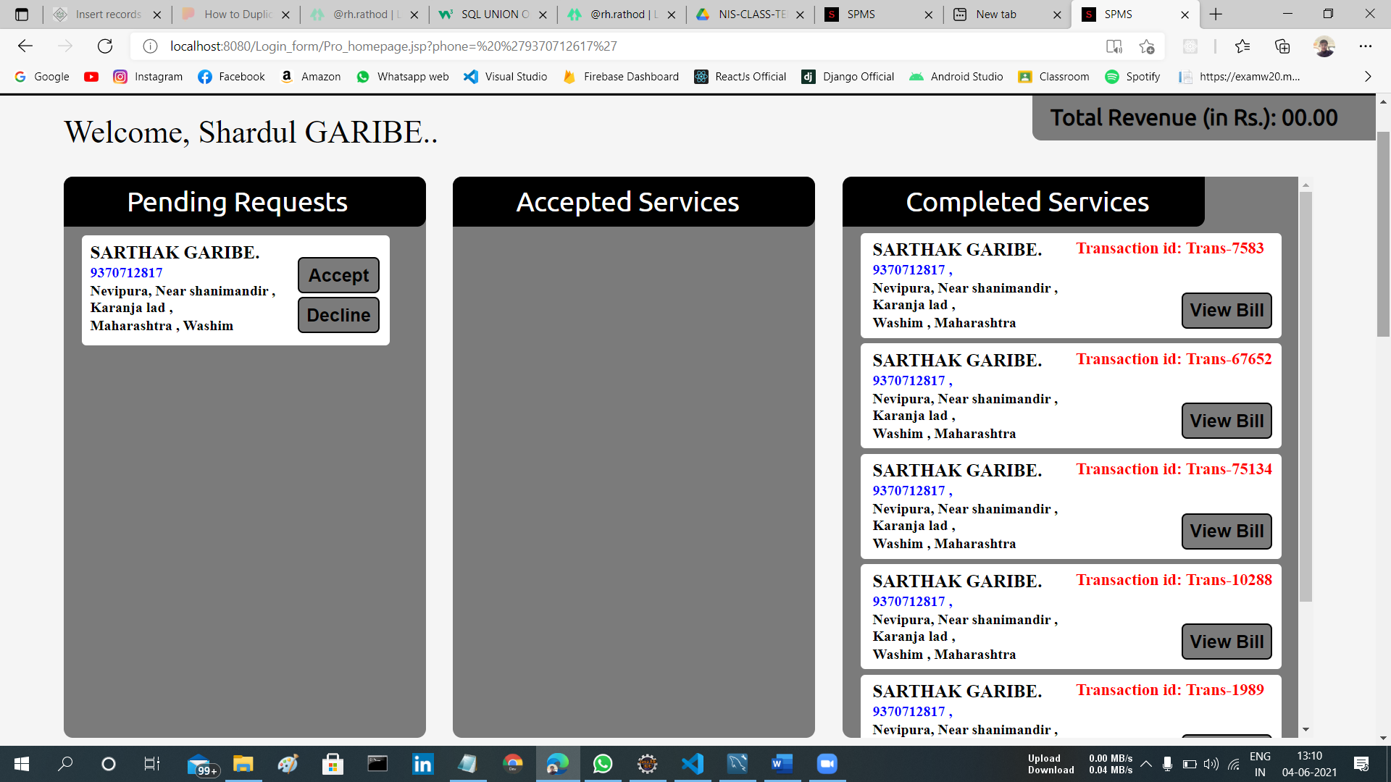
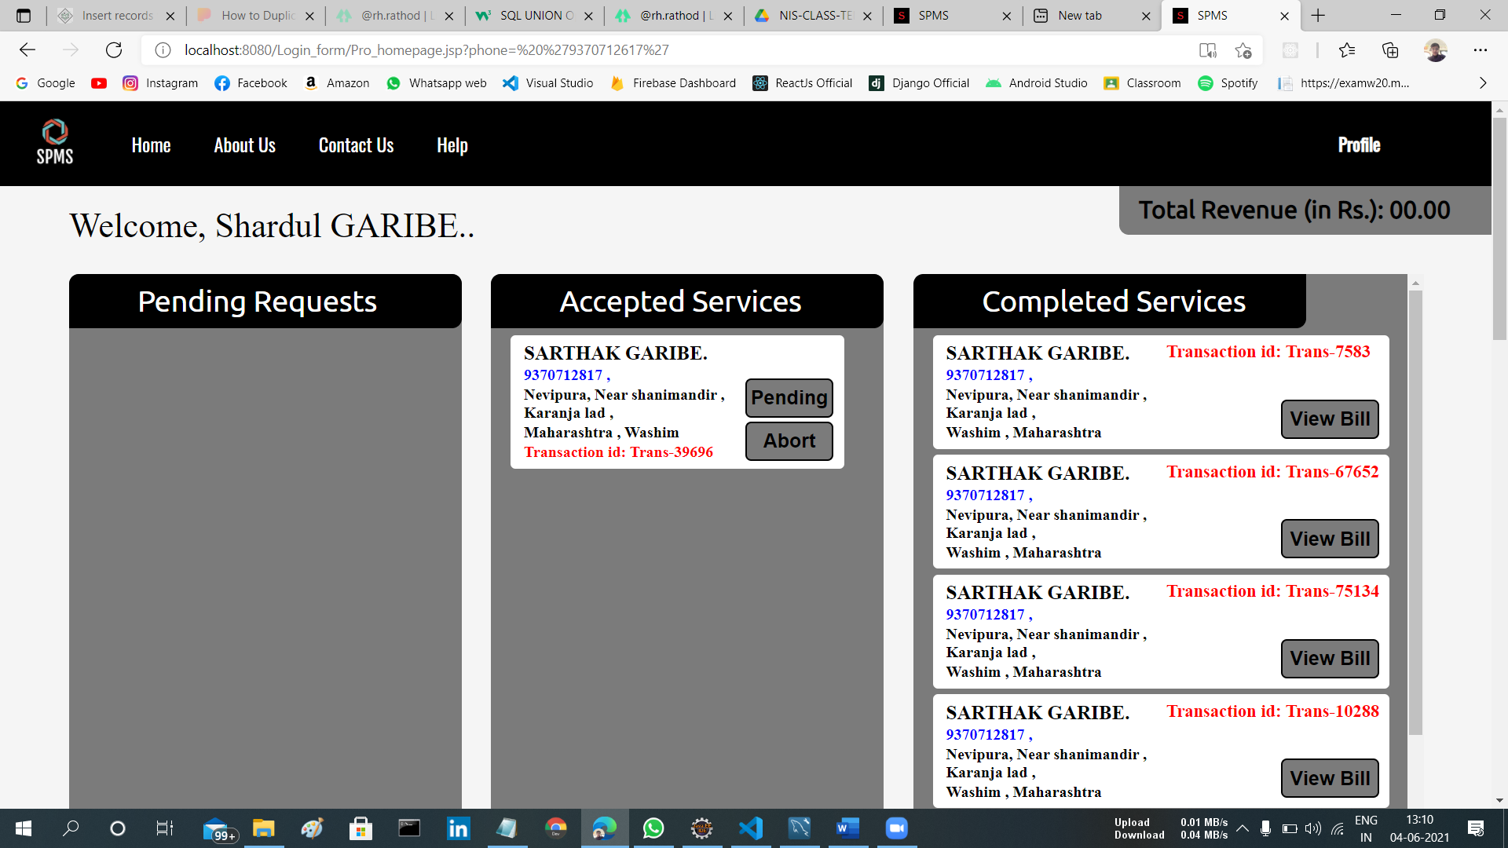
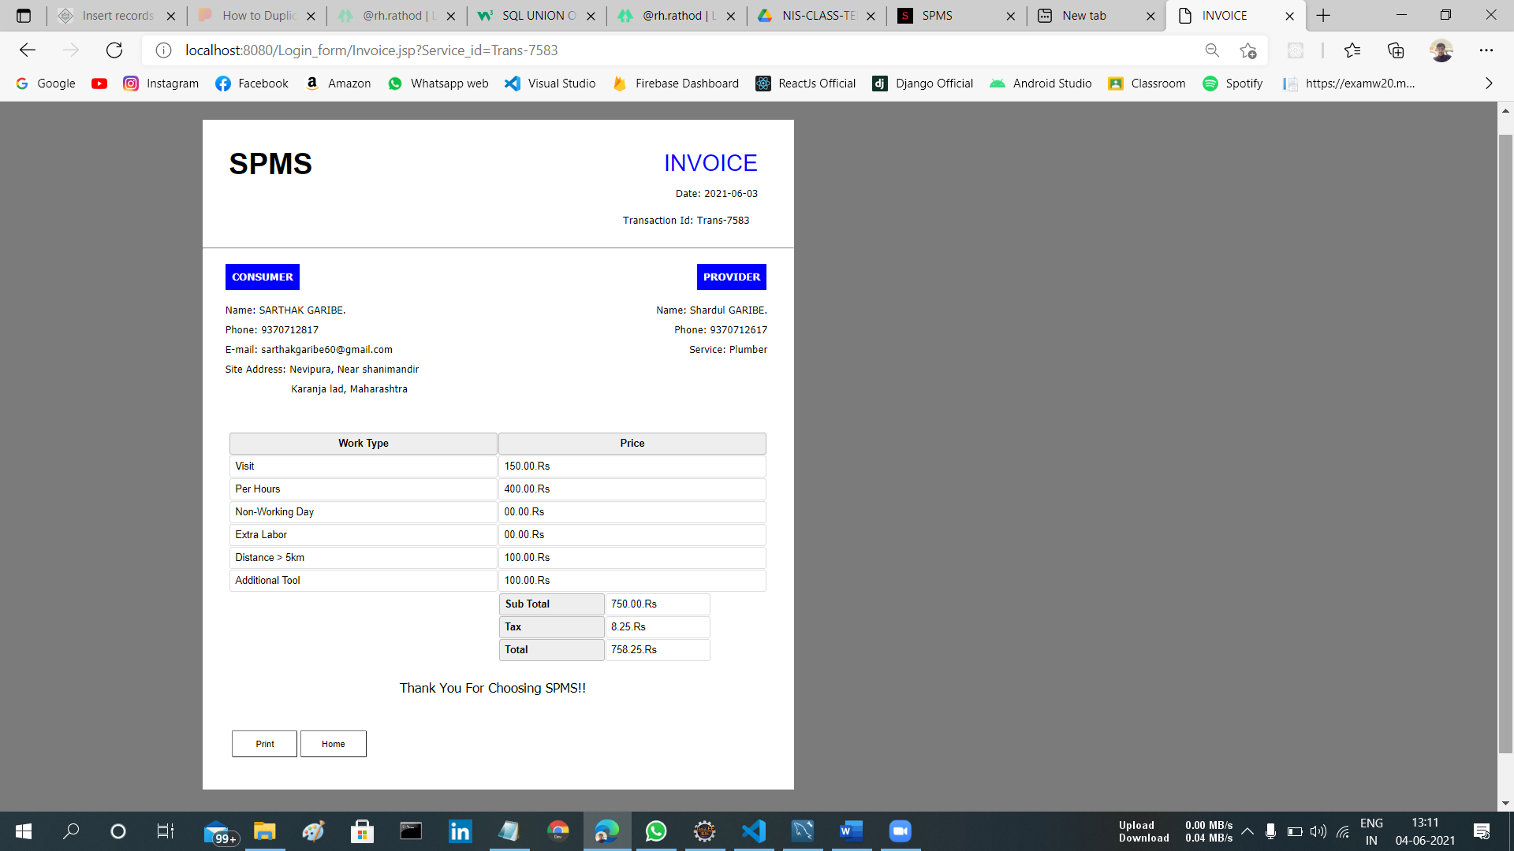
Request In Provider Sides.
SPMS

Slide 14
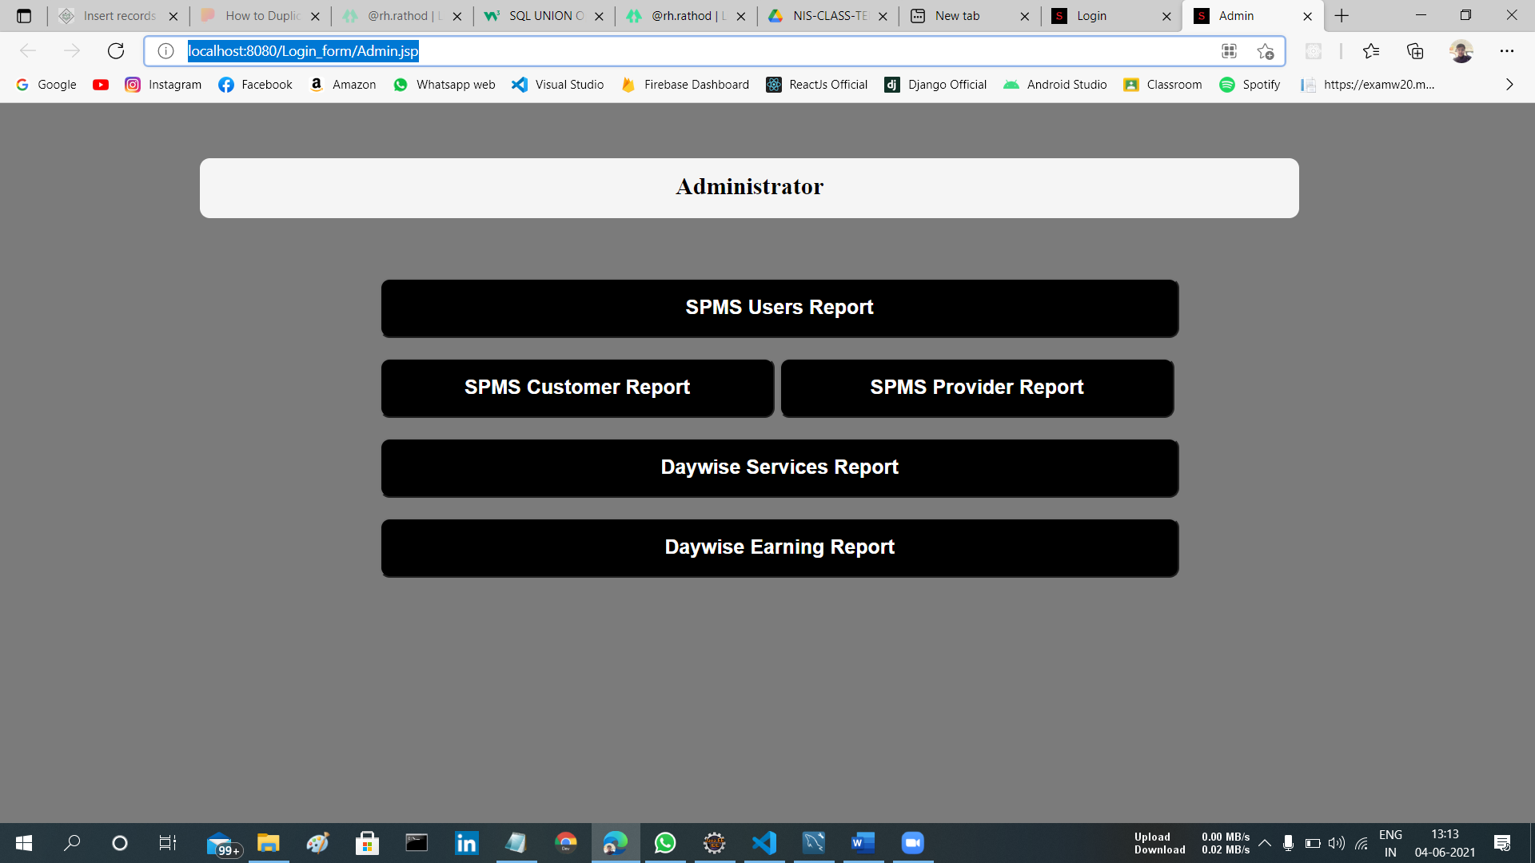
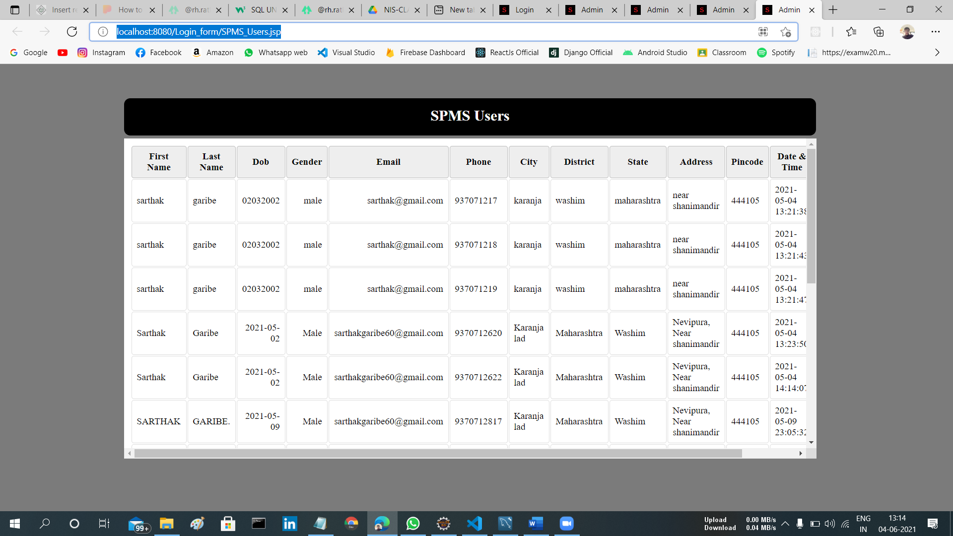
Admin.
SPMS User Report.
SPMS

Slide 15
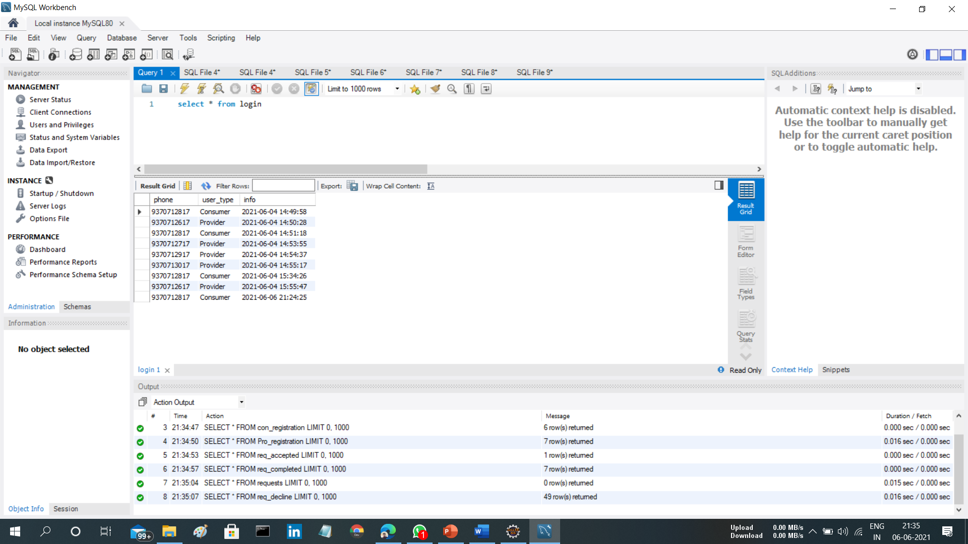
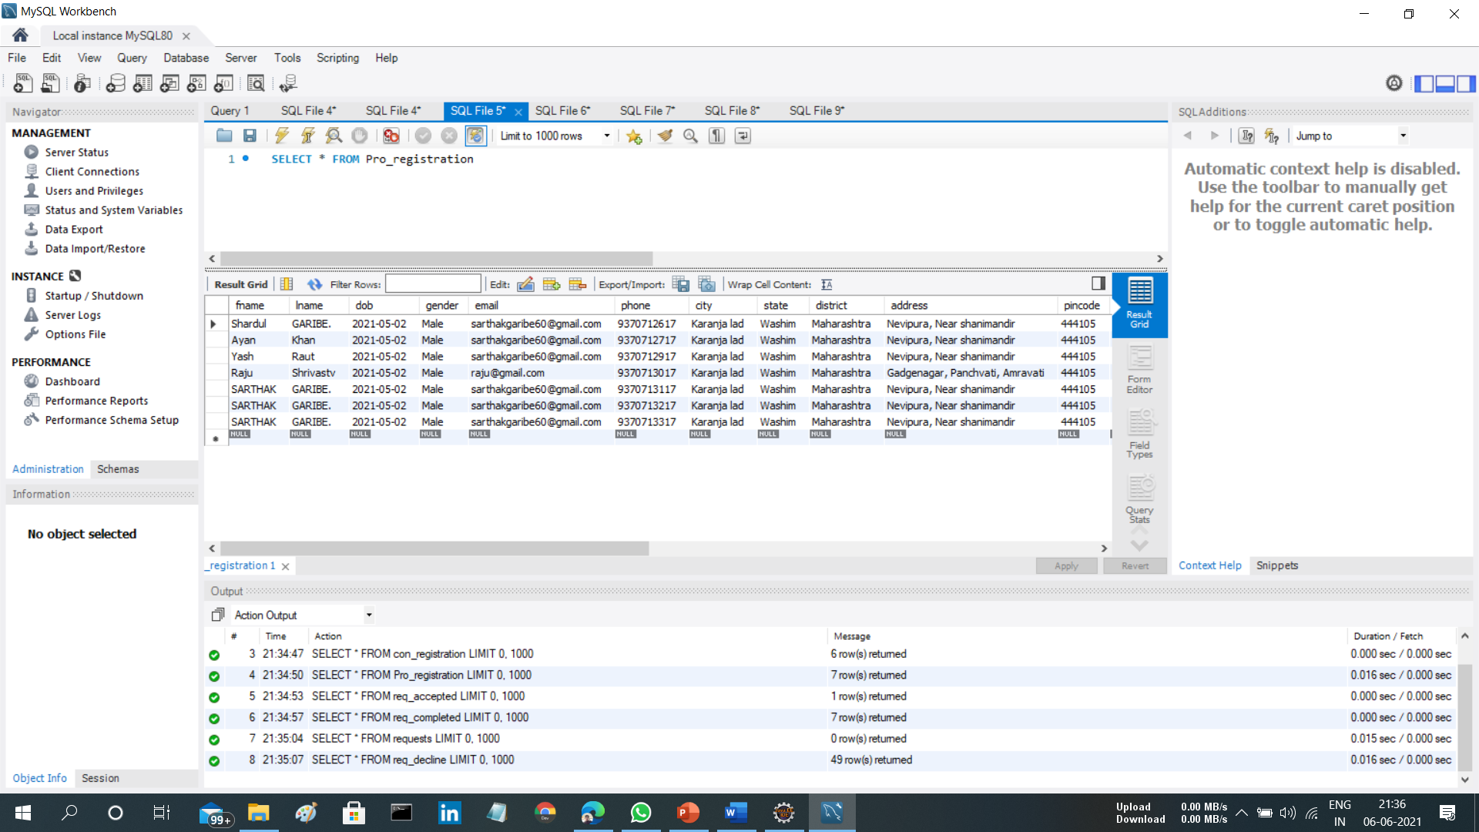
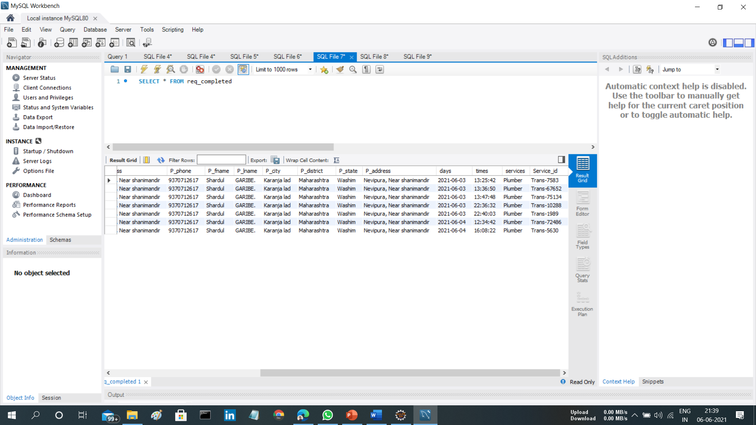
Sample Database.
Login.
Registration.
Request.
SPMS

Slide 16

Dataflow.
Limitations.
Payment transfer
Deal cancelation
Message API
GPS
Ratings
Admin charges
SPMS

Slide 17

Applications.
Medium of connectivity
Service Booking
Analyzing wages
Provider as Consumer
SPMS

Slide 18
Scope.
User profile
Registration
Service
Request approval
Admin
Minimum wages
Listing
Services
Authentication
Update
Providers
Wages
Maximum Wages
Work status
Tax
Report generation
Bill
SPMS

Slide 19

Advantages.
Ease in booking services.
Provides employment.
Time efficient.
End of looting consumers.
Right to choose provider.
SPMS

Slide 20

Conclusion.
Software to provide:
Provider for service
Minimum efforts
Bill receipt
Getting work done
Report to analyze
SPMS

Slide 21
Thank you
SPMS

